Slide 1
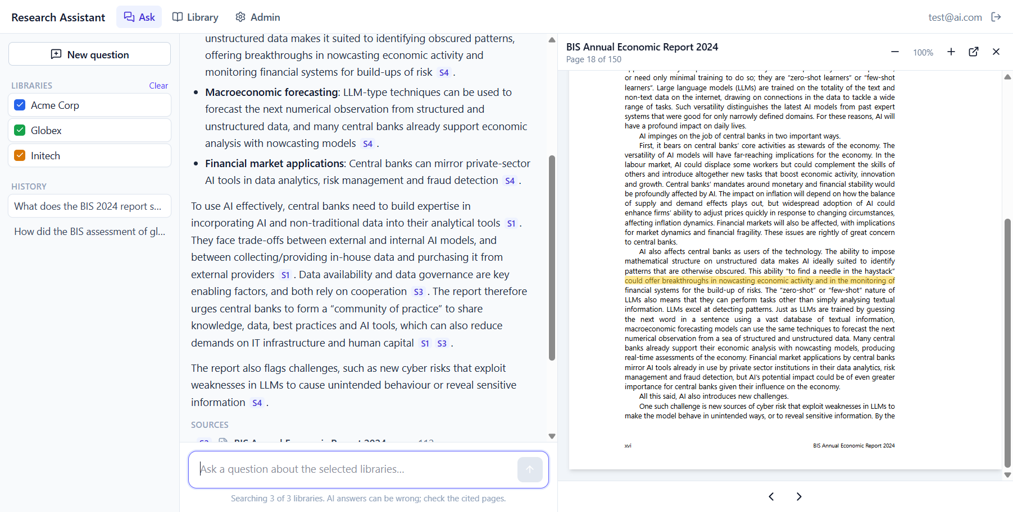
AI Research Intelligence Assistant
CONCEPT PROPOSAL
Ask questions across a company's research library. Get answers grounded in the reports, cited to the exact page.
Working prototype, running today
Notes:
Hi everyone. I'm going to show you an AI research assistant that lets customers ask questions across a company's research library and get answers they can verify. The key point up front: this isn't just a concept. What you see on the right is a screenshot of the working prototype, answering a real question from real reports, with the source page open and the evidence highlighted.

Slide 2



The research is valuable, but it's locked inside PDFs
THE PROBLEM
Slow to find
Hard to connect
Costly to commit
Users open reports one by one and search inside each.
Questions across reports and years mean reading many documents.
A full enterprise platform is a big bet before value is proven.
Goal: prove that customers get faster, trustworthy answers from the research they already have, before a larger investment.
Notes:
Here's the problem. The company has years of research, but it's published as PDFs. Finding something means opening reports one by one. Connecting information across reports or years, like how a view changed since 2022, means reading many documents. And building a full enterprise platform before we know customers value this would be a big bet. So the goal is to prove the value cheaply first.

Slide 3
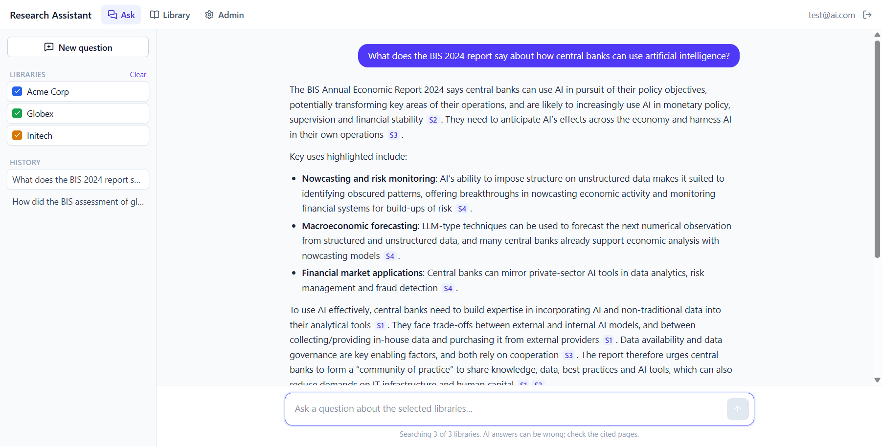
Ask the library, get a cited answer
THE SOLUTION
1 · Choose libraries
One company's research or several.
2 · Ask in plain language
The answer streams in, citing every claim.
3 · Verify in one click
Each citation opens the exact page.
Notes:
This is how it works for a user. They pick the libraries they're allowed to search, then ask in plain language. On the right is a real answer from the prototype. I asked what the BIS 2024 report says about how central banks can use AI. The answer is structured, and every sentence carries a citation chip, S1 to S4, pointing at specific pages of the report.

Slide 4
Every claim links to its page
Clicking citation S4 opens the BIS 2024 report at page 18 of 150 and highlights the evidence.
Notes:
Trust is the whole game here, so verification is one click. When I click citation S4, the actual PDF opens beside the answer at page 18 and highlights the exact sentence the claim relies on. Page references use the physical page in the file, not the printed number, because reports often use roman numerals or restart numbering. So the citation always lands on the right page.

Slide 5

Three agents, and every answer is checked
HOW IT WORKS
Question
Query Agent
Hybrid search
Answer Agent
Evaluator Agent
plus chosen libraries
plans the search
meaning + keywords
cites every claim
checks each claim
Web app
API
Data
AI models
React, with a built-in PDF viewer and admin panel
Python FastAPI on Vercel; streams answers
Supabase: Postgres + vector search, Auth, file storage
DeepSeek for answers and checks; gte-small embeddings
Notes:
Under the hood, uploaded PDFs are split page by page and indexed for both meaning and keywords. Each question goes through three agents. The Query Agent plans the search and splits comparison questions into sub-queries. The Answer Agent writes only from the retrieved pages and must cite every claim. The Evaluator Agent then checks each claim against its cited page. If something is unsupported, the answer is rewritten once, and if it still fails it's flagged as low confidence. The stack is all managed services: React, FastAPI on Vercel, Supabase and DeepSeek.

Slide 6

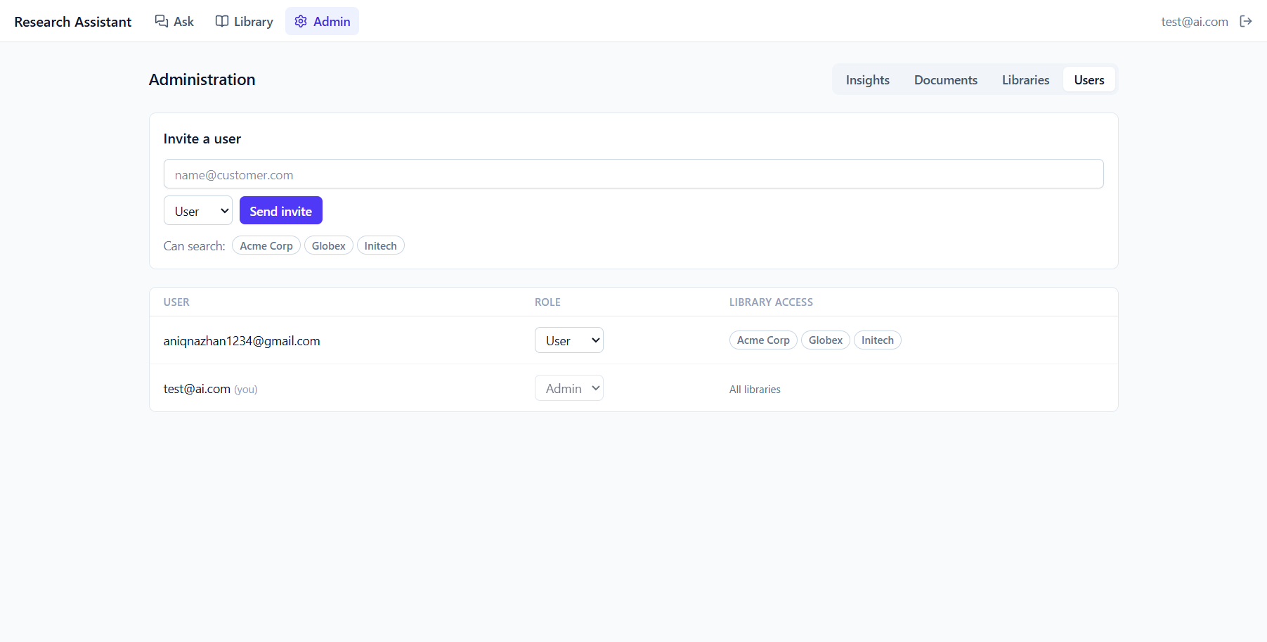



Users only see the libraries they're granted
ACCESS CONTROL
Invite-only sign-in with admin and user roles
Per-user library grants set by an admin
Enforced in the database, so search can't reach other libraries
Private PDFs served through short-lived links
24 automated security tests pass
Notes:
Restricting access to authorised users was a core requirement. Accounts are invitation-only, and an admin decides which libraries each user can search, as on the right. Crucially, this is enforced inside the database with row-level security, not just hidden in the interface. Even if someone names another library directly, search returns nothing. PDFs sit in a private bucket and are served through short-lived links. There are 24 automated tests proving this.

Slide 7
Quality is measured, not assumed
QUALITY AND EVIDENCE
Offline metric (golden set) | Target
Right pages retrieved (Recall@10) | ≥ 85%
Citations support the claim | ≥ 90%
Unanswerable questions declined | ≥ 90%
Correctness vs. expert answer | tracked
530
100%
report pages indexed in testing
grounded on the test questions
19–28 s
< 4¢
per answer, check included
model cost per question
Found in testing: reference lists can crowd out body text in search. The assistant declined rather than guessing; a fix is planned for pilot week 1.
Notes:
How do we know the answers are good? Every live answer gets the evaluator's grounded score, and users can rate it; admins see this on an Insights dashboard. Offline, there's an evaluation runner for an expert-written test set, with targets like 90% citation accuracy. Early numbers: 530 pages indexed, the test answers were fully grounded, around 20 to 30 seconds per answer, and under 4 cents of model cost per question. To be transparent, testing also found a weakness: reference lists can crowd out body text in search. The assistant declined instead of guessing, which is the right behaviour, and the fix is planned for week one of the pilot.

Slide 8
A 4-week pilot with real customers
NEXT STEP
Week 1
Week 2
Week 3
Week 4
Fix retrieval, load 1–2 libraries, write the test set
Onboard 5–10 users; timed tasks vs. manual search
Open use; tune weekly from Insights and feedback
Interviews, results, go/no-go recommendation
≥ 50%
≥ 90%
≥ 85%
≥ 70%
faster than manual search
citation accuracy
right pages retrieved
answers rated helpful
The ask: approve a 4-week pilot. It proves customer value at low cost before any enterprise investment.
Notes:
So what's next? I'm proposing a four-week pilot with five to ten real customer users on one or two libraries. Week one fixes the retrieval issue and builds the test set. Week two is onboarding and a timed comparison against manual search. Week three is open use with weekly tuning. Week four is interviews and a go/no-go recommendation. Go means hitting these targets: at least 50% faster, 90% citation accuracy, 85% retrieval and 70% helpful ratings. The ask today is to approve that pilot. Thank you, happy to take questions or show it live.

